Slide 1
DATA VISUALIZATION
23.03.2022

Slide 2
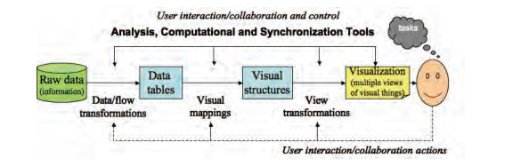
The Visualization Process in Detail

Slide 3
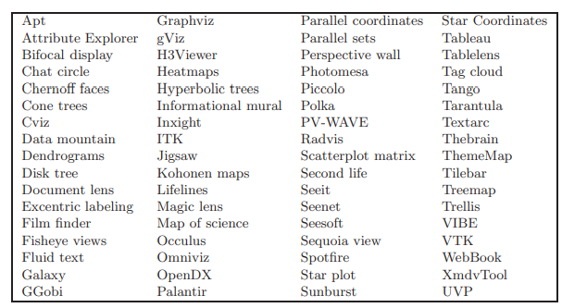
Available tools and packages for data visualization

Slide 4
Data preprocessing and transformation.
The starting point is to process the raw data into something usable by the visualization system.
The first part is to make sure that the data is mapped to fundamental data types for computer ingestion.
The second step entails dealing with specific application data issues such as missing values, errors in input, and data too large for processing.
The data may be simulated or sampled. Missing data may require interpolation. Large data may require sampling, filtering, aggregation, or partitioning

Slide 5
Telemetry data
Telemetry data is the collection of measurements or other data at remote or inaccessible points and their automatic transmission to receiving equipment for monitoring
Example: track the movements of wild animals that have been tagged with radio transmitters, and to transmit meteorological data from weather balloons to weather stations.

Slide 6
Mapping for visualizations.
Once the data is clean, we can decide on a specific visual representation.
This requires representation mappings: geometry, color, and sound, for example.
It is easy to simply develop a nonsense visualization or one that conveys the wrong information

Slide 7
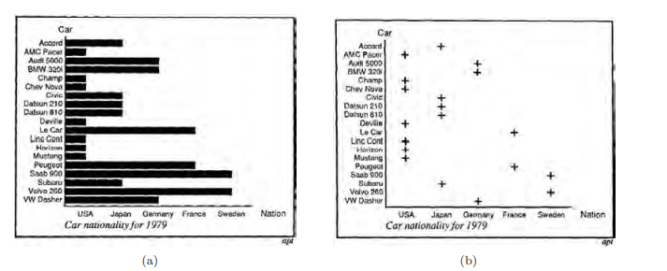
Better use of graphs and plots

Slide 8
The dissection of choosing a right plot
By having the bars extend over each of the x-coordinate tick marks, there is an implication that the x-coordinate is involved, when no such association occurs.
For example, the Volvo, second row from the bottom, cuts across several x-values (USA, Japan, Germany, . . . ) until it gets to Sweden.
Crucial influences on the visualization of data sets are expressiveness and effectiveness.
It is an interesting exercise to develop measures or metrics for expressiveness and effectiveness; after all, we do use them as measures.

Slide 9
Rendering transformations
The final stage involves mapping from geometry data to the image.
This includes interfacing with a computer graphics Application Programmer’s Interface (API).
We need to select the viewing parameters, shading technique if 3D, device transformations (for display, printers, . . . ).
This stage of the pipeline is very dependent on the underlying graphics library.
Expressiveness: An expressive visualization presents all the information and only the information. Expressiveness thus measures the concentration of information.

Slide 10
Measure of expressiveness
Given information that we actually display to the user, we can define one measure of expressiveness as the ratio Mexp of that information, divided by the information we want to present to the user.
We have 0 ≤ Mexp ≤ 1. If Mexp = 1 we have ideal expressiveness. If the information displayed is less than that desired to be presented, then Mexp < 1.
If Mexp > 1, we are presenting too much information. Expressing additional information is potentially dangerous, because it may not be correct and may interfere with the interpretation of the essential information.
Such a measure of expressiveness may be extended to include various sets of information, in which case it becomes a function on sets

Slide 11
Measure of effectiveness
A visualization is effective when it can be interpreted accurately and quickly and when it can be rendered in a cost-effective manner.
Effectiveness thus measures a specific cost of information perception.
We can define a measure of effectiveness Meff as some ratio similar to that for expressiveness. However it is a bit more complex.
What we want is a measure such that for small data sets we measure interpretation time (since rendering is usually very fast) and when that time increases, either due to the increasing complexity or the size of the data set, Meff decreases, emphasizing the rendering time.

Slide 12
Contd.
Meff = 1/(1 + interpret + render).
We then have 0 < Meff ≤ 1.
The larger Meff is, the greater the visualization’s effectiveness.
If Meff is small, then either the interpretation time is very large, or the rendering time is large. If Meff is large (close to 1), then both the interpretation and the rendering time are very small

